Slide 1
Sensors & Transducers

Slide 2
Sensors
Devices that detect and measure physical properties or inputs from the physical environment.
Sensors can detect various parameters such as temperature, pressure, light, humidity, motion, and many more.
Example: Thermistors: They measure temperature by measuring the change in resistance of the electric current, Photosensors: detect the presence of visible light, infrared transmission, or ultraviolet energy

Slide 3
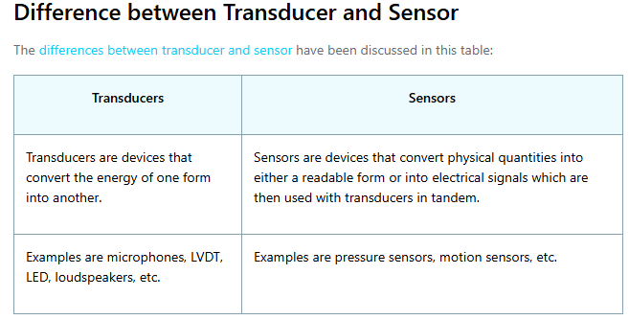

Slide 4
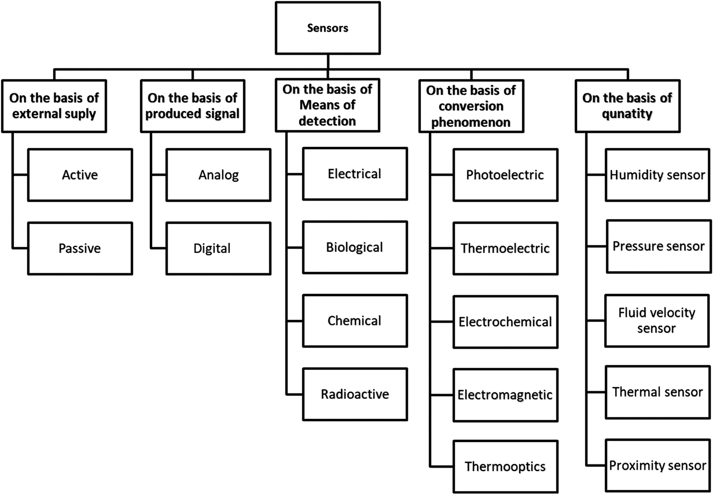

Slide 5
Few Real-life Applications of Sensors
Medical devices like digital thermometers and MRI machines that monitor patient temperatures.
Aerospace applications: They also measure cabin pressure, altitude, and hydraulic system performance.
Smart devices: Sensors also enable touchless gestures in smartphones and voice assistants.
Cameras and imaging systems: Enable autofocus, HDR, and ambient light adjustments in smartphones and digital cameras.
Environmental monitoring: Measure air pollution and gas levels in smart city applications.
Proximity sensors automatically turn off smartphone screens when placed near the ear.

Slide 6
Transducers
Transducers are a type of sensor that not only detects physical quantities but also converts one form of energy into another.
They act as both sensors and actuators, allowing the measurement of a physical parameter and the conversion of that measurement into a usable form (most common form is electrical energy.
For example, a microphone is a transducer that converts sound waves into electrical signals

Slide 7
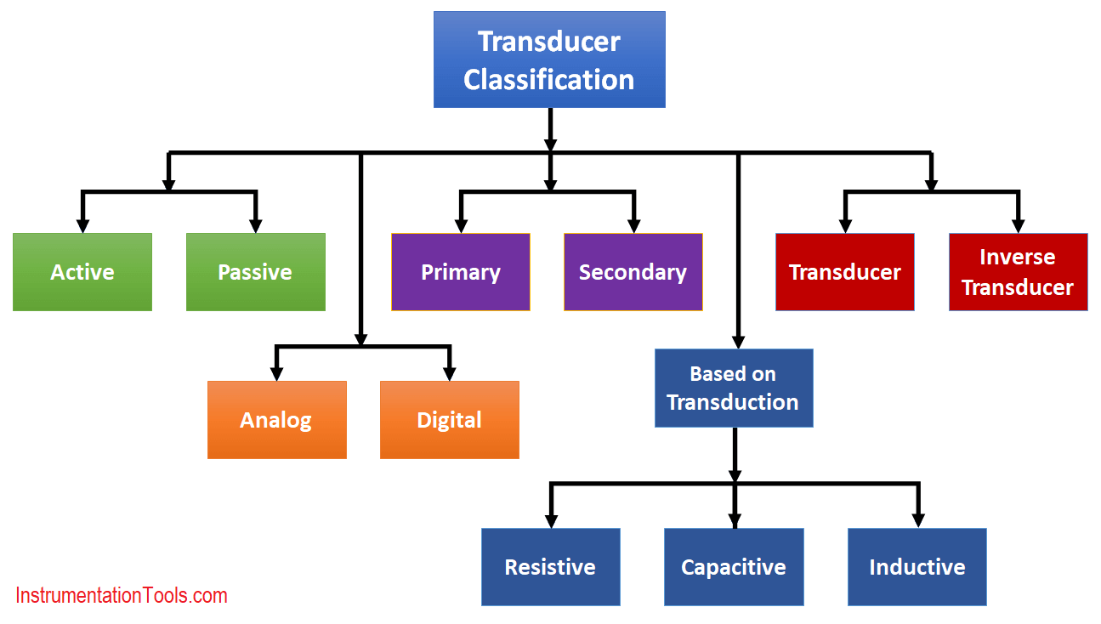

Slide 8
Few Real-life Applications of Transducers
Microphones: Microphones convert sound waves into electrical signals. They are used in a wide variety of applications, such as recording studios, public address systems, and hearing aids.
Speakers: Speakers convert electrical signals into sound waves. They are used in a wide variety of applications, such as home stereos, car stereos, and public address systems.
Hydrophones: Hydrophones convert sound waves in water into electrical signals. They are used in a variety of applications, such as underwater communication, sonar, and oceanography.
Geophones: Geophones convert ground vibrations into electrical signals. They are used in a variety of applications, such as seismology, oil exploration, and mining.
Accelerometers: Accelerometers convert acceleration into electrical signals. They are used in a variety of applications, such as navigation, robotics, and medical devices.

Slide 9
Actuators
Actuators are devices that convert electrical signals into physical action or movement.
Unlike sensors that measure physical properties, actuators generate a physical response based on the signals they receive.
Examples of actuators include motors, solenoids, valves, and relays.

Slide 10
Few Real-life Applications of Actuators
1. In factories , actuators run machines, move conveyor belts, and control robot arms. They help make products faster, more accurately, and with less human error.
2. In aeroplanes, actuators control things like landing gear, flaps, and engines. They must work perfectly to keep flights safe and smooth.
3. For robots, actuators let robots move and do tasks like picking things up, welding, or painting. The type of actuator used affects how well the robot works.
4. In vehicles, actuators help with steering, braking, and engine control. They make driving safer, easier as well as more fuel-efficient.
5. In heating and cooling systems, actuators control airflow, fans, and temperature settings to keep rooms comfortable.
6. In Smart Homes, actuators are used in smart homes to open blinds, lock doors, and turn on lights automatically. This generally makes life easier and saves energy.
7. In healthcare, actuators are found in things like artificial limbs, surgical robots, and testing machines. They help doctors as well as improve patient care.

